Slide 1
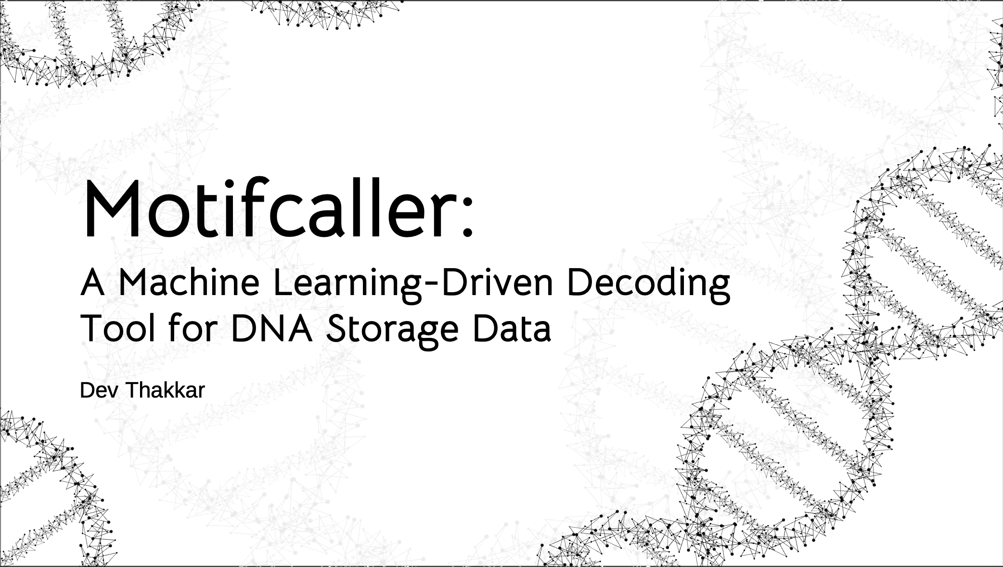

Slide 2
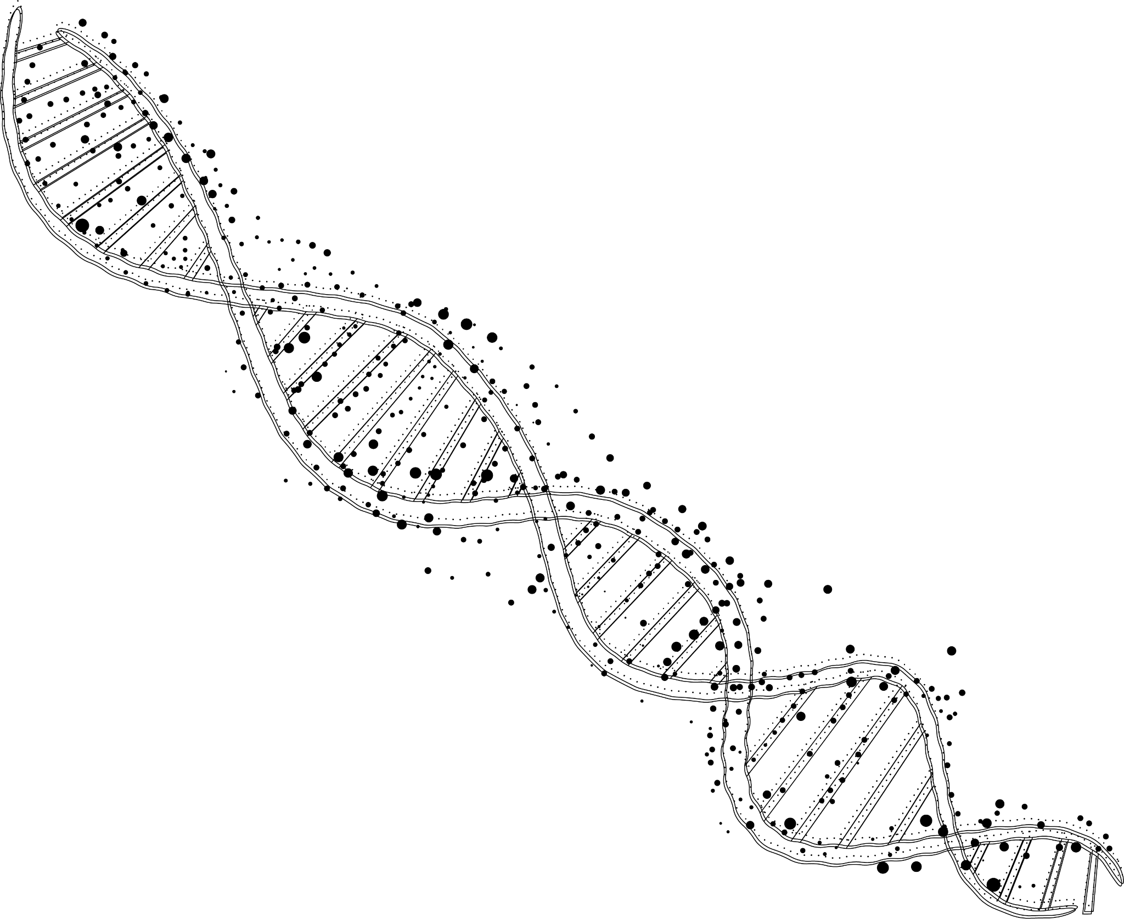
Definitions
DNA: Molecule storing genetic or digital data using nucleotide sequences.
DNA Double Helix: Spiral structure of two DNA strands holding encoded information.
Nucleotide Base: Building block of DNA, representing data with A, T, C, or G.
Motif: Repeating DNA pattern, e.g. [A T C G] [A T C G].
Base pairs: A-T and C-G pairs that stabilise DNA.
Notes:
To begin with I’ll cover some quick simplified definitions in the context of this project that will be important for those who might not be as brushed up on their biology. Talk about last 3 definitions.

Slide 3
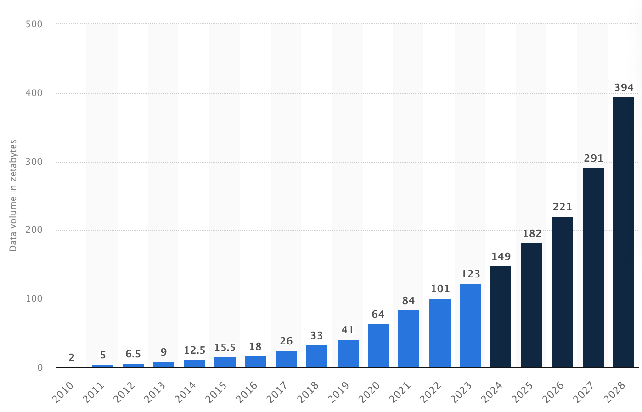
Motivation
Volume of data/information created, captured, copied, and consumed worldwide from 2010 to 2023, with forecasts from 2024 to 2028 (in zettabytes) [1]
Notes:
It being predicted that data volumes will hit 400 zettabytes.
Cold Storage ~ 60% of all stored data
DNA Storage – High Density solution Potential to store exabytes of data in a single gram of DNA.
Summer: Microsoft DNA Storage Team + Helixworks
Let’s start with the motivation behind the project. With global data generation skyrocketing—Statista projects data volumes to hit nearly 400 zettabytes in the next few years—the limitations of traditional storage methods are becoming starkly evident. DNA storage offers an incredibly high density and durability solution, with the potential to store exabytes of data in a single gram.
Last summer, I reached out to experts in the field, including members of Microsoft’s DNA Storage team and several innovative startups in the US and Europe. In one particularly insightful conversation with a team at Helixworks, I learned about the significant software challenges in decoding DNA storage data. Their insights confirmed that while the biology behind DNA storage is fascinating, a real engineering hurdle lies in efficiently decoding noisy raw nanopore signals. This conversation was pivotal, driving the focus of my project toward creating a streamlined, machine learning–based solution.

Slide 4
The Problem
Binary
Motifs
00 | ACGT
01 | TGCA
10 | CAGT
11 | GTAC
Notes:
Simplified version of how DNA Storage works.
Say we want to store 00 and 11
Actually: Result of lookup depends on preceding nucleotide
Here is a simplified version of how DNA Storage occurs currently. Now in an actual sequencing its important to note that the the result of the lookup should also depends on the preceding nucleotide but that will be outside the scope of this presentation as its not necessary to understand the software problem, but is important to note when making our solution. Okay so we have the following mapping from binary to a grouping of nucleotides, or motifs. And we want to try to store 00 11.

Slide 5
The Problem
Binary
Motifs
00 | ACGT
01 | TGCA
10 | CAGT
11 | GTAC
Notes:
Pay Attention to first and last rows.
Biological constraints, can’t just put motifs for 00 and 11 together.
Unique Spacer Motif
So the relevant motifs we would want to pay attention to are the first and last rows. Then we would need to synthetise these to form our actual DNA. Now due to biological constraints, you can't just directly combine our motifs for 00 and 11 together as imagine for a more complex sequence you wouldn’t expect the synthesis to result in a stable DNA Strand so therefore it is important to have this unique spacer Motif.

Slide 6
The Problem
Binary
Motifs
Spacer Motif
00 | ACGT
01 | TGCA
10 | CAGT
11 | GTAC
GCAT
GC
Motif
AT
Notes:
Say Spacer Motif = GCAT
Split to GC, AT and sandwich motif in between
Say this spacer motif is GCAT. Where will split this up into 2 and have one part on onside of a motif and the other on another side, so essentially sandwich things together.

Slide 7
The Problem
Final Composite Sequence
Motif 1
Motif 2
GC
ACGT
AT
GC
GTAC
AT
00
11
TA CG
Notes:
Final Composite Sequence of 00 11 looks like this.
Oversimplification as spacer motifs vary slightly to meet biological constraints to maximise DNA Stability.
So our final composite sequence of 00 11 looks like this. Again, this is an oversimplification because in real sequencing, the spacer motif may vary slightly each time to best meet biological constraints to maximise DNA stability.

Slide 8
Final Composite Sequence
Motif 1
Motif 2
GC
ACGT
AT
GC
GTAC
AT
TA CG
Bridging Motif
Notes:
Final composite sequence has corresponding bridging sequence made up of bridging motifs
These bridge motifs are essentially just the base pairs of our original sequence
This final composite sequence then has a corresponding Bridging Sequence made up on the base pairs so we also have almost a corresponding sequence made up of bridge Motifs. Collectively these are synthesised together to form a DNA Double Helix.

Slide 9
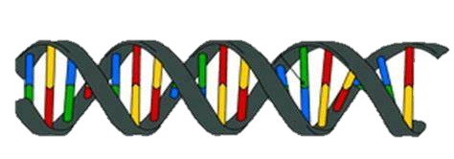
Motif 1
Motif 2
GC
ACGT
AT
GC
GTAC
AT
TA CG
Bridging Motif
DNA Synthesis
DNA Double Helix [2]
Notes:
Collectively these are synethesised together to form a DNA Double Helix.
However, we only care about about original composite sequence
We pass this sequence those nanopore sequencer
However, we only care about our original composite sequence as it contains the motifs with information we want so this will be the only strand which passes through the nanopore sequencer

Slide 10
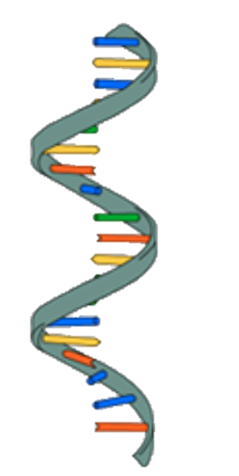
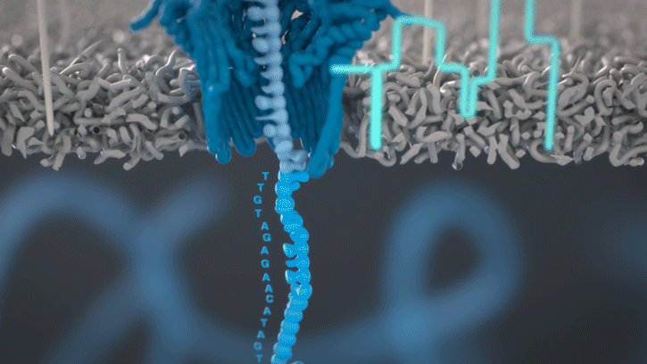
Single Stranded DNA [2]
Nanopore Minion DNA Sequencing [3]
Notes:
The raw signal outputted from the nanopore sequencer reflects characteristic patterns of our entire composite sequence.

Slide 11
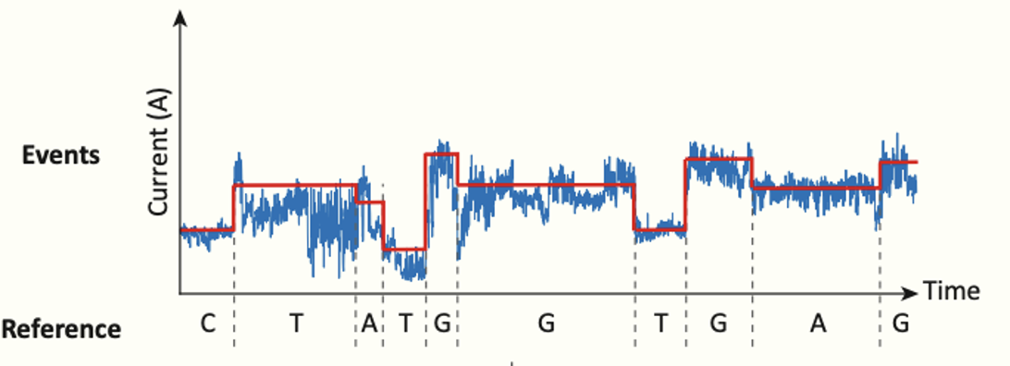
Nanopore Minion DNA Sequencing [3]
Example relationship between DNA sequence and Nanopore raw data [4]
Notes:
As seen here variance in the signal relates to specific nucleotides and we are hoping to exploit this behaviour to get to our original motifs and finally the binary mappings.
So let me restate the Problem I am hoping to tackle with our original example.

Slide 12
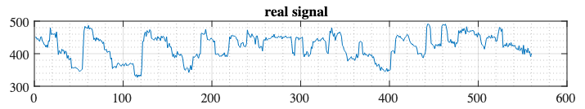
The Problem
Final Composite Sequence
Real Raw Nanopore Signal [5]
Motif 1
Motif 2
GC
ACGT
AT
GC
GTAC
AT
Notes:
So given this raw nanopore signal, can I find these Motifs in the red box.
Now there are some additional limitations which are worth noting and why Machine Learning is so important to the solution. Firstly, the nanopore sequencing technology we saw earlier is not perfect so that results in a lot of noisy reads which the model you make should be able to handle this. Secondly, the data is typically not as nice as to simply say if its between 430 – 450 Amps we have Nucleotide C. As mentioned before, a nucleotide typically depends on a nucleotide given before and so there are typically underlying patterns which must be found to make a successful model.

Slide 13
Existing Approaches
Real Raw Nanopore Signal [5]
Basecalling [4]
GCACGTATGCGTACAT
Sequence Alignment
Motif 1
Motif 2
GC
ACGT
AT
GC
GTAC
AT
*Note: not actual result from nanopore signal
Notes:
First let's look at existing approaches. Traditionally, DNA storage decoding has relied on two key steps:
Basecalling: Converting raw nanopore electrical signals into nucleotide sequences using Neural Networks
Sequence Alignment: Comparing these sequences against known references to identify motifs.
While these methods are well-established, they are computationally intensive and not scalable for the massive datasets.
My main Objectives I must clear: - Develop an “end to end” model which given these nanopore signals will perform significantly better than random guessing - Develop a command-line interface
Additional Objectives: - Achieve >90% accuracy: Beat basecalling + sequence alignment models

Slide 14
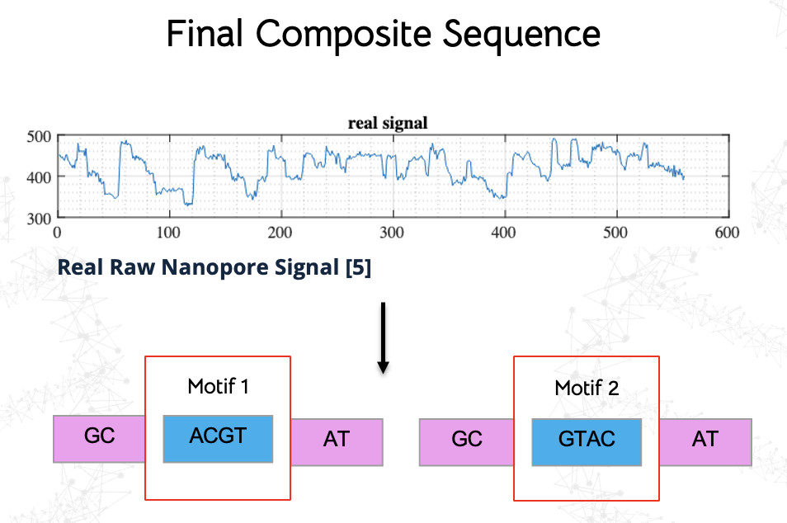
Interesting Observation
Notes:
But Before I start with my Approach, I am going to highlight an interesting observation I had when first seeing this problem. So in the problem we are given a signal and we want to find these motifs directly from pretty noise data. Now this seems very similar to the Automatic Speech Recognition Systems that we have seen over the past few years get really good.

Slide 15
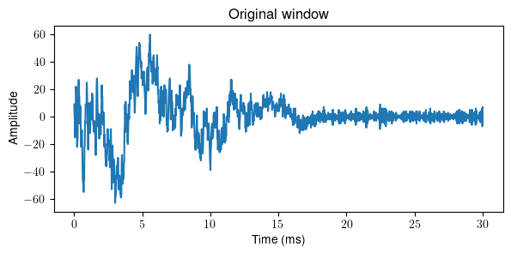
Interesting Observation
Visionaries
psychiatric
wards
are
full
of
them
Real example of sound waves with its corresponding representation of words spoken [7]
Notes:
[Explain how Automatic Speech Recognition works ngl] So on the right we have a real speech waves and its corresponding words, so Automatic speech recognition essentially when given a wave of a similar form to the one given, can you in real time, find the words associated to it. And the problem on the right has been able to perform really well despite noise. So much like ASR systems this method leverages deep learning architectures that combine the strengths of convolutional and transformer-based models.

Slide 16
Synthetic Data
Real Raw Nanopore Signal [5]
Squigulator (to make “squiggle”)* [5] *+extra interim steps
Signal Processing
y = ACGT, TGCA, CAGT, ... TGCA, TGCA, GTAC, ... CAGT, TGCA, ACGT, ...
X = 451, 455, 455, 444, 451, ... 503, 502, 507, 455, 478, ... 451, 455, 444, 451, 455, ...
*Note: This diagram is for demonstrative purposes only
Notes:
So presume I now have synthetic data which of our X value which is the signal data, and the y value are the motifs we want to end up (or our ground truth).
Squigulator Mention (noisy)
Motif accuracy is guessing one motif correctly. Sequence accuracy is guessing an entire sequence correctly

Slide 17
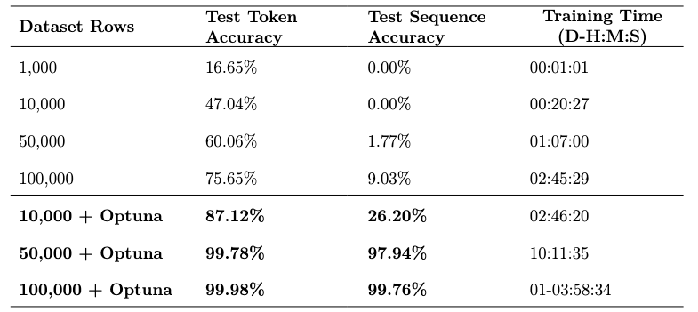
Table 1: Showing performance of CNN-Transformer-GRU without hyperparameter turning and with hyperparameter tuning (Optuna)
Notes:
So initially I set on a CNN-Transformer-GRU Model, which is a similar to model to they have tested in Automatic Speech Recognition, as an initial benchmark, where each of the pieces, so the CNN, Transformer, GRU would then be tested to see its effectiveness, which no paper I had seen had done previously. CNN “hears” local audio features, a transformer “understands” the whole sentence and a GRU “writes” the words.

Slide 18
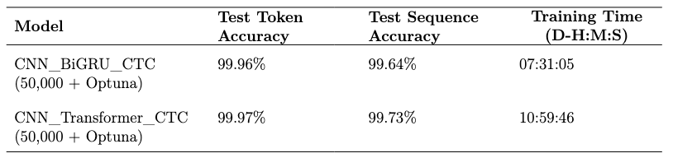
Table 2: Showing performance of CNN-Transformer-CTC with hyperparameter turning (Optuna) vs CNN-BiGRU-CTC with hyperparameter tuning (Optuna)
Notes:
BiGRU is a two way memory of recent words. CTC is like mapping an entire audio clip to text without ticking off each word in order.
CNN–Transformer–CTC: like ASR’s CNN→transformer→CTC (syllable→sentence→spell), it spots base-pair motifs, builds global context, then aligns them into bits. Key difference is it builds global context
CNN–BiGRU–CTC: like ASR’s CNN→BiGRU→CTC (syllable→bi-context→spell), it spots motifs, captures two-way context, then aligns them into bits. Captures two way context

Slide 19
Future Directions
Real Nanopore Signal Data
Advanced Unsupervised Methods: -> Targeted microbial sequencing [10] -> Future-proofing future encodings of DNA Storage
Notes:
Work with real data? – Working with Helixworks. Unsupervised learning for general nanopore sequencing problem

Slide 20
References & Questions
[1] Statista, “Global data volume 2010-2028,” 2024. [Online]. Available: https://www.statista.com/statistics/871513/worldwide-data-created
[2] Biology Online. "Single-stranded DNA." [Online]. Available: https://www.biologyonline.com/dictionary/single-stranded-dna
[3] Oxford Nanopore Technologies. "How nanopore sequencing works," 2019. [Online]. Available: https://www.youtube.com/watch?v=RcP85JHLmnI
[4] Menkovski, V. "Simulation of Nanopore sequencing (with generative models)," [Online]. Available: https://vlamen.github.io/mscproject/nanopore/ [5] Hasindu Gamaarachchi. "GitHub - hasindu2008/squigulator: a tool for simulating nanopore raw signal data," [Online]. Available: https://github.com/hasindu2008/squigulator
[6] Yan, Y., Pinnamaneni, N., Chalapati, S., Crosbie, C., & Appuswamy, R. "Scaling logical density of DNA storage with enzymatically-ligated composite motifs," 25 September 2023. [Online]. Available: https://www.nature.com/articles/s41598-023-43172-0 [7] Bäckström, T., Räsänen, O., Zewoudie, A., Pérez Zarazaga, P., Koivusalo, L., Das, S., Gómez Mellado, E., Bouafif Mansali, M., Ramos, D., & Vali, M. "3.4. Short-time analysis of speech and audio signals," [Online]. Available: https://speechprocessingbook.aalto.fi/Representations/Short-time_analysis.html
[8] Kim, S. "Sooftware Speech - Conformer Paper Review," 30 August 2020. [Online]. Available: https://sooftware.io/conformer/
[9] Martin, S., Heavens, D., Lan, Y., Peel, N., Irish, N., Horsfield, S., Giolai, M., Clark, M. D., & Leggett, R. M. "A Comparison of Nanopore Data Types, Basecalling, and Assembly Algorithms: Whole Plant Genome Assembly and Methylation Analysis from a Single MinION Flow cell," 13 November 2024. [Online]. Available: https://www.biorxiv.org/content/10.1101/2024.11.13.623402v1.full.pdf
[10 Wan, Y. K., Hendra, C., Pratanwanich, P. N., & Göke, J. "Beyond sequencing: machine learning algorithms extract biology hidden in Nanopore signal data," [Online]. Available: https://www.cell.com/trends/genetics/pdf/S0168-9525(21)00257-2.pdf
Notes:
Key Takeaways: At its core, automatic speech recognition (ASR) can be reframed as a problem similar to decoding information from DNA storage. So the solutions we see don’t just advance one domain, they ripple across others, and accelerate progress in fields that share similar structural problems and that’s why its important to always maintain a look at the begin picture as we enter the coming years. CNN recognises the specific segmentations of sound. Transformer understands the words in context. GRU keeps track of the sentences. BiGRU is a two way memory of recent words. CTC is like mapping an entire audio clip to text without ticking off each word in order.
Why is basecalling and sequence alignment resourcefully intensive: Sequence alignment algorithms perform dynamic programming over long sequences, which can be very slow and memory intensive.

Slide 21
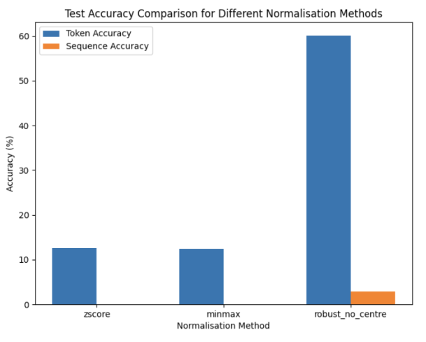

Slide 22
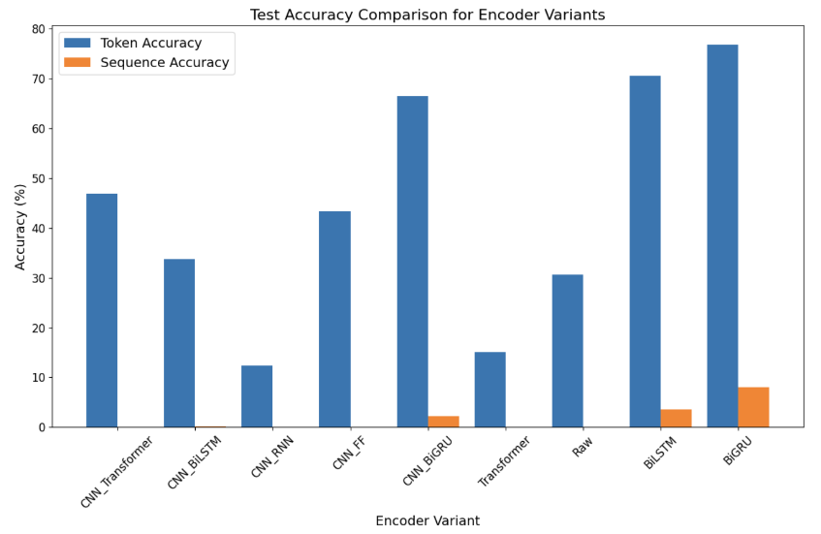

Slide 23
